Slide 1
NAVIGATING HEALTH CARE AFTER A DOUBLE WHAMMY
NO JOB
NO HEALTH CARE

Slide 2
WHY IS YOUR HEALTH INSURANCE TIED TO YOUR JOB?
YOUR HARDWORKING FAMILY SHOULD HAVE HEALTH CARE SECURITY EVEN IF YOU LOOSE YOUR JOB

Slide 3
502,057 Applied for unemployment in Colorado since March 2020

Slide 4
Another 975,000 applied for jobless aid under a separate program for self- employed and gig workers

Slide 5
13% OF Colorado’s adults are uninsured 780,000 Coloradans

Slide 6
Number who would have lost their health insurance coverage during the pandemic if Medicare for All 1384 had passed when it was first introduced zero

Slide 7
Number of people who would have health insurance coverage if HR 1384 had Passed: EVERYONE WHO LIVES IN AMERICA

Slide 8
Your hard working family would have health security even if you lost your job

Slide 9
How would we pay for it? A TAX For almost all of us, the tax would be less than we would pay for premiums, copays and deductibles

Slide 10
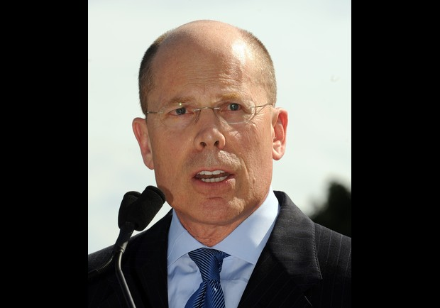
Why would it be less expensive? Because we would eliminate all the unnecessary administrative costs.

Slide 11
How would it prevent you from getting sick or injured? Your families would have preventive care

Slide 12
What would it mean if you got sick or injured? Everything you needed would be covered

Slide 13
What can YOU do? Advocate!
HR1384 2019-2020
Improved Medicare for All
Sponsored by Congresswoman Primila Jayapal

Slide 14
What can YOU do? Advocate!
2019-2020 Health Care Emergency Guarantee Act
Sponsored by Congressswoman Primila Jayapal

Slide 15
What can YOU do? Advocate!
HR 5010 2019-2020 State based Universal Health care
Sponsored by Congressman Ro Khanna

Slide 16
How can you find out who represents you in Congress?
Google
govtrack.us
Type in your address

Slide 17
How can you advocate?
Ask
Congressman Ed Perlmutter
to co-sponsor
5010 and 6906.
Thank him for co-sponsoring 1384

Slide 18
How can you advocate?
Thank
Congressman
Joe Neguse
for co-sponsoring
1384, 6906 and 5010

Slide 19
How can you advocate?
Ask
Congresswoman
Diana DeGette
to co-sponsor
5010 and 6906
Thank her for co-sponsoring 1384

Slide 20
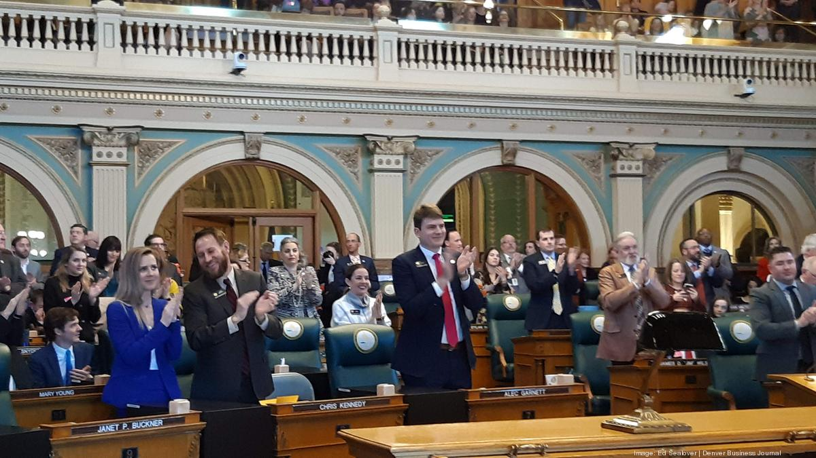
How can you advocate?
Ask
Congressman Jason Crow
to co-sponsor
1384
5010
6906

Slide 21
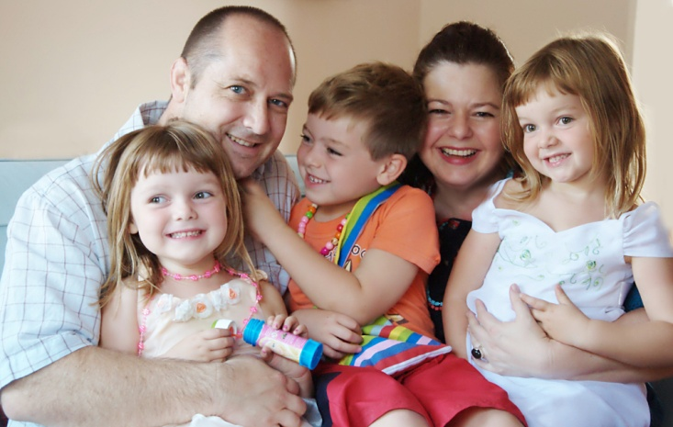
But these bills have not passed so what can you do right now to provide immediate healthcare security for your family? Arvadans for Progressive Action has invited an expert on current health care resources to speak with you. Cathy will introduce your next speaker.

